Slide 1
Software Tool for Plant Pathometry & Estimation of Nutrient Content
B.Tech Project (EEN-400B)
Harshit Khetan - 17115038
Parv Bhatt - 17115063

Slide 2
Motivation
Annual crop losses due to diseases is estimated to be around $60 billion worldwide.
Farmers are unaware about which disease is harming their crops and what preventive measures needs to be taken.
Since the leaf of the crop is the mirror to its health, we decided to process the image of a crop’s leaf to detect what type of disease it has and what nutrients the crop is lacking.

Slide 3
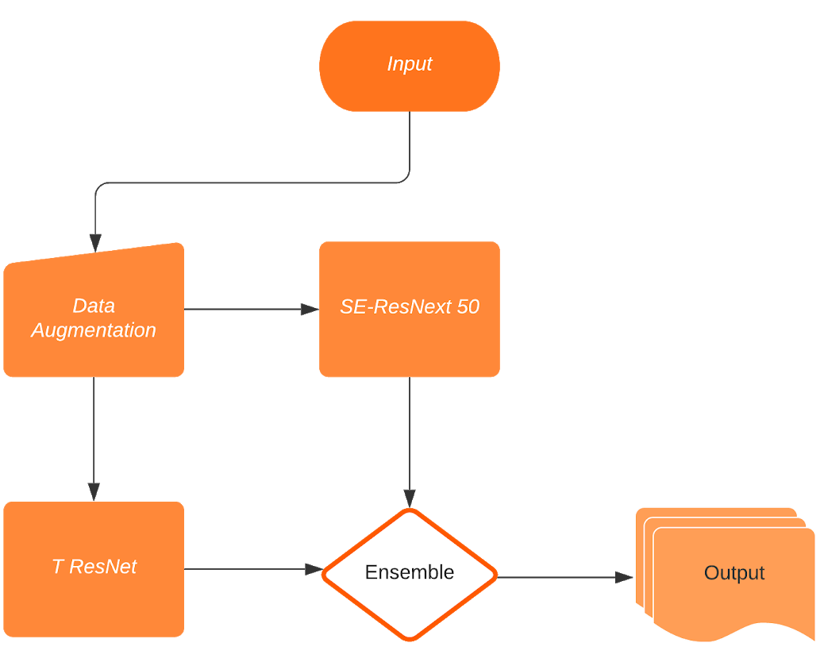
Proposed Method for Disease Classification

Slide 4
Experimental Results
Method | F - Score %
SE-ResNext 50 | 93.53%
T ResNet | 87.12%
Ensemble | 94.13%

Slide 5
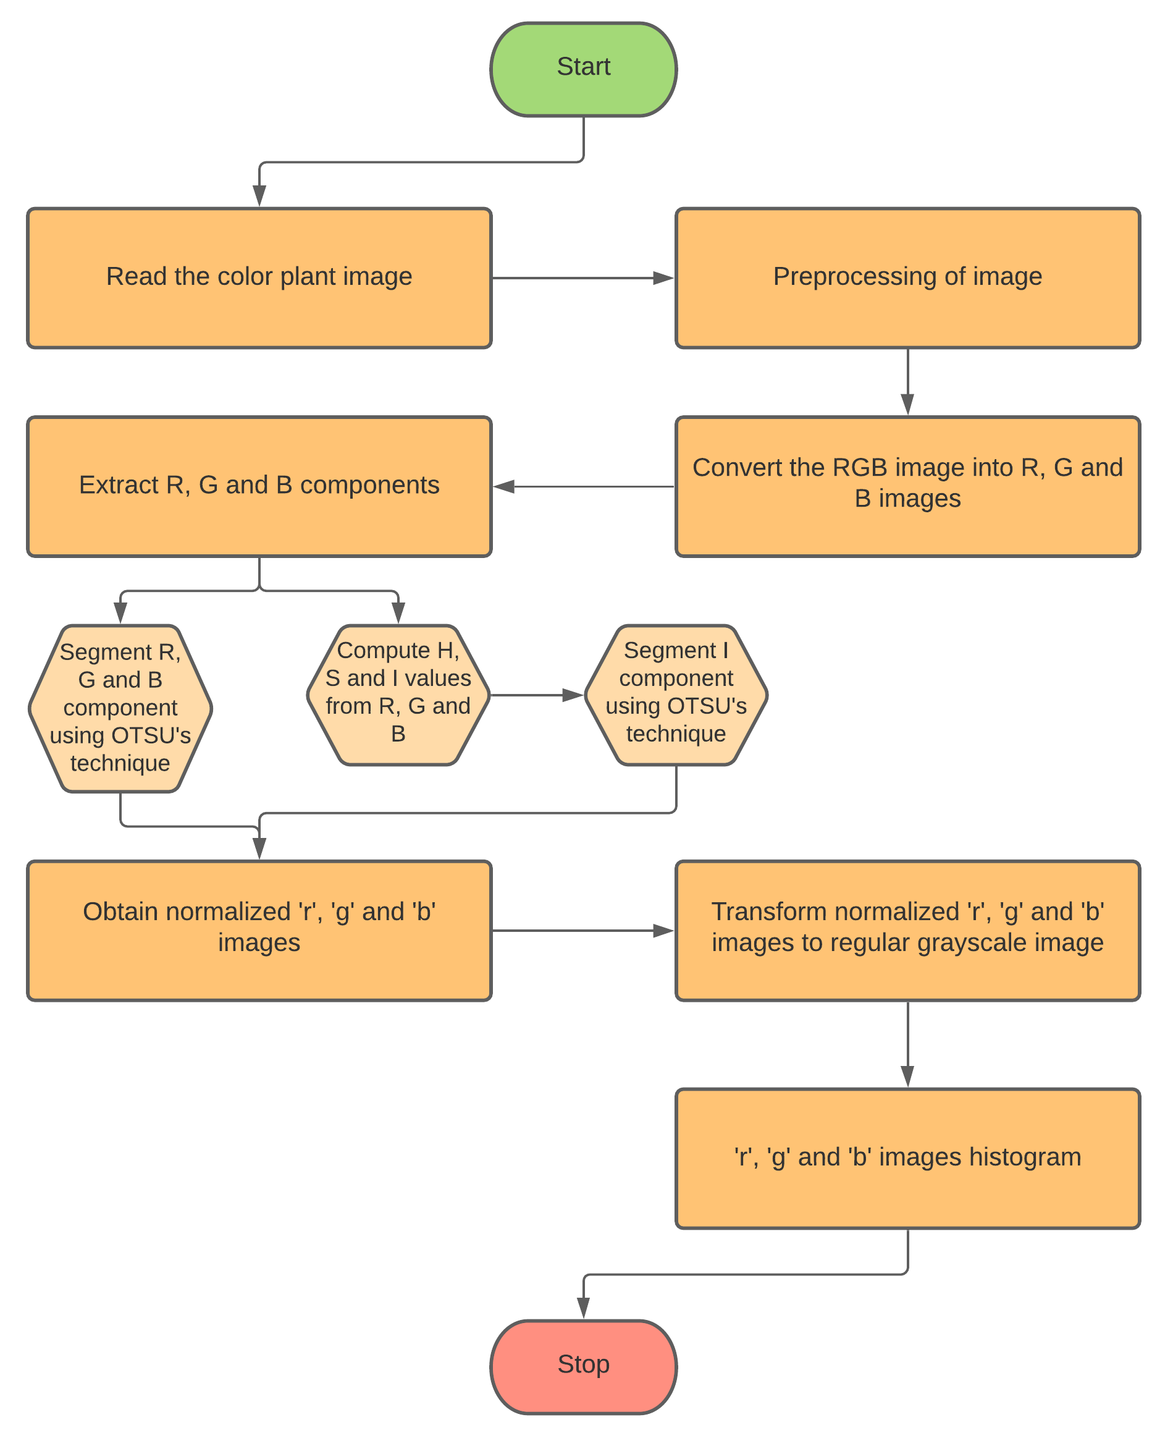
Embedded Image Processing

Slide 6
Prediction of Plant Nitrogen Content
Regression models to correlate image features and the plant nitrogen content, estimated by chemical analysis with Kjeldahl method.
Some of the Image features that we used were R, G, B, R/(R+G+B), G/(R+G+B), B/(R+G+B), R-G, R-B, G-B, (R-G)/(R+G), (R-B)/(R+B), (G-B)/(G+B), (R-G)/(R+G+B), (R-B)/(R+G+B), (G-B)/(R+G+B), NORMALISED ‘r’, NORMALISED ‘g’, NORMALISED ‘b’.

Slide 7
Nitrogen Percent = 8*10⁻⁵*(r²) – 0.0162*(r) + 0.8778
Prediction of Plant Nitrogen Content
Total 140 samples were used to develop the prediction model and 80 samples were used for validation.

Slide 8
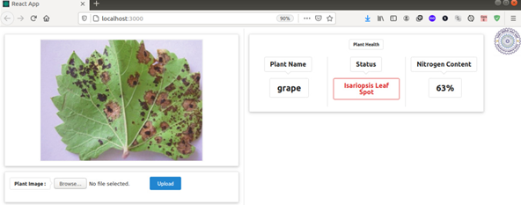
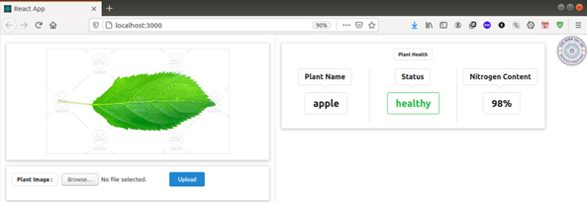
Web Application

Slide 9
References
Zhaowei Cai and Nuno Vasconcelos. Cascade r-cnn: Delving into high-quality object detection. In Proceedings of the IEEE conference on computer vision & pattern recognition, pages 6154–6162, 2018.
Tsung-Yi Lin, Piotr Doll' ar, Ross Girshick, Kaiming He, Bharath Hariharan, & Serge Belongie. Feature pyramid networks for object detection. In Proceedings of the IEEE conference on computer vision & pattern recognition, pages 2117–2125, 2017.
Kaiming He, Xiangyu Zhang, Shaoqing Ren, & Jian Sun. Deep residual learning for image recognition. In Proceedings of the IEEE conference on computer vision & pattern recognition, pages 770–778, 2016.
Otsu, N. 1979. A threshold selection method from gray-level histogram. IEEE Trans. Systems Man Cybern. 9 (1): 62-66.
Chapman, H. D., and P. F. Pratt. 1961. Method for Analysis of Soils, Plants and Waters. Univ. of California, USA.
Sandino, J.; Pegg, G.; Gonzalez, F.; Smith, G. Aerial mapping of forests affected by pathogens using UAVs, hyperspectral sensors, and artificial intelligence. Sensors 2018, 18, 944.
Siqueira, R.; Longchamps, L.; Dahal, S.; Khosla, R. Use of fluorescence sensing to detect nitrogen and potassium variability in maize. Remote Sens. 2020, 12, 1752.
Aranguren, M.; Castellón, A.; Aizpurua, A. Crop sensor based non-destructive estimation of nitrogen nutritional status, yield, and grain protein content in wheat. Agriculture 2020, 10, 148.

Slide 10
Thank You

Slide 11
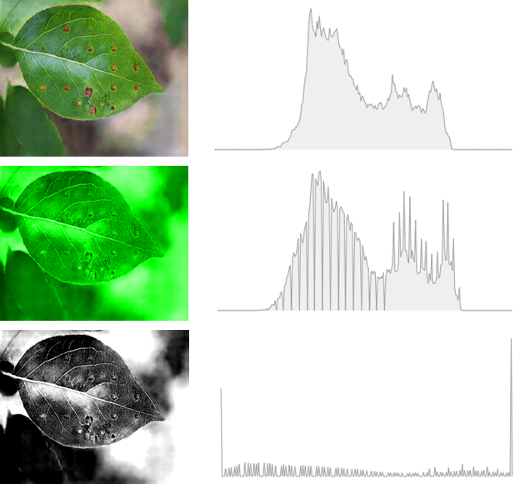
Sample Image Processing
Original Image
G Image
Normalized ‘g’ Image

